Slide 1
AirKitchen:
Week 11 Update
Team FoodXYZ
Mengdan Yuan, Wen Xin

Slide 2
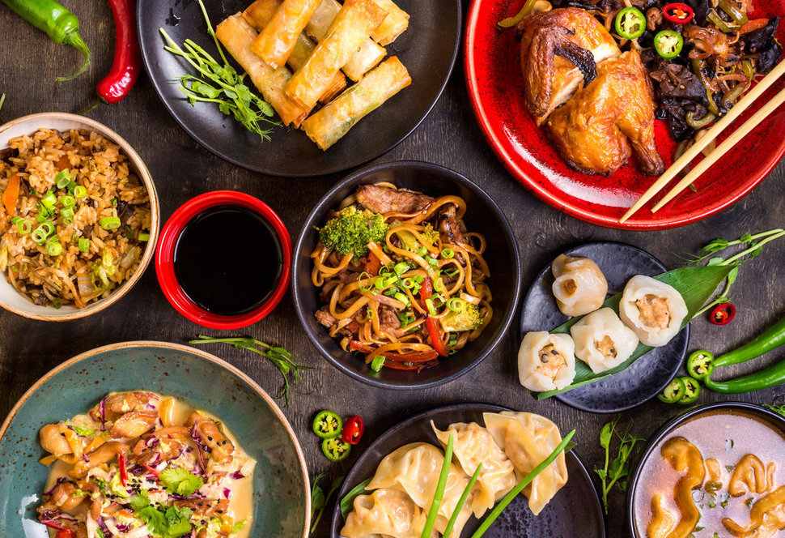
https://img.huffingtonpost.com/asset/585be1aa1600002400bdf2a6.jpeg?ops=scalefit_970_noupscale

Slide 3
Model Improvement
Add Features:
pca
cluster
Model:
Try LSTM with daily features and compare
Stack

Slide 4
Model Performance
Model | Train | Test
Logistic Regression | 0.8815 | 0.8732
Ridge Classification | 0.8837 | 0.8723
Light GBM | 0.8932 | 0.8767
Random Forest | 0.8913 | 0.8754
Neural Network | 0.8812 | 0.8764
Stack(lightGBM+Random Forest Neural Network) |  | 0.8781
LSTM(+daily feature) | 0.8651 | 0.8644

Slide 5
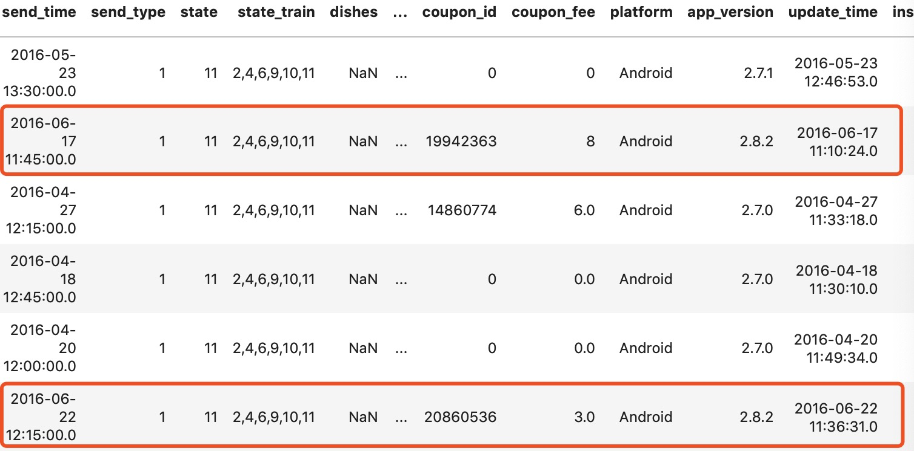
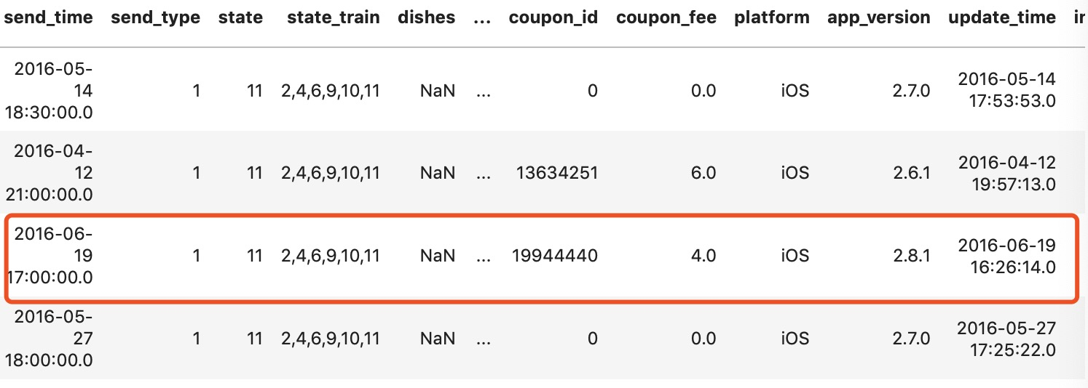
Preliminary Error Analysis
User 100788125
Analyzed users with true label 1 but got predicted to be 0
Check each order they make
Our guess:
coupons attracts users
User 100792048
Next steps:
Find common patterns in users’ features who was wrongly classified as 0
Compare it with true label 1 users and true label 0 users

Slide 6
Survival Analysis Define
Time to event
Event of Interest: Placing an order
Start: The second last time a user place an order
End: The last time a user place an order
Censored: Users who only place one order during the 3 months of data we have

